Slide 1


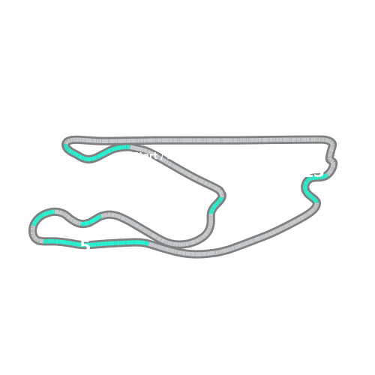


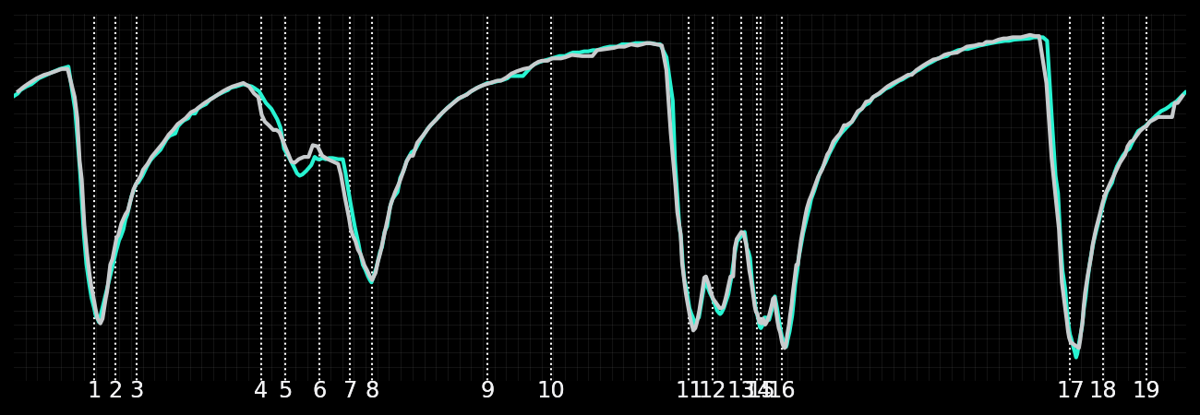
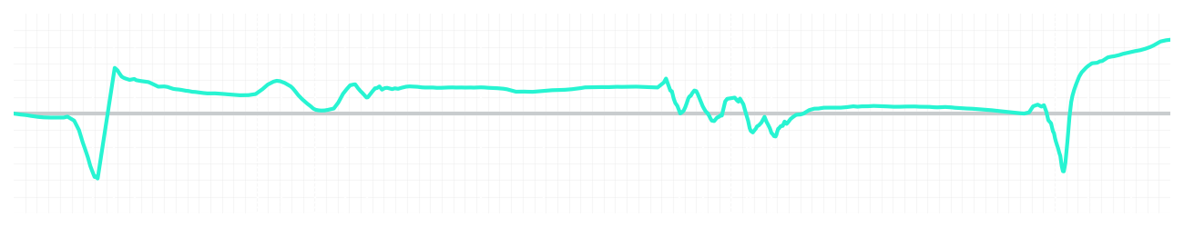
Miami GP Sprint Quali Q2
Kimi Antonelli
Driver
George Russell
Driver
Lap Time
01:27.384
01:27.666
Lap Time
Sector 1
29.056
Speed Trap 1
221 kp/h
Speed Trap 1
219 kp/h
Sector 1
29.100
Sector 2
33.309
Speed Trap 2
192 kp/h
Gap
-0.282
Gap
0.282
Speed Trap 2
192 kp/h
Sector 2
33.271
Sector 3
25.019
Speed Final Line
286 kp/h
Corner Advantage
11/20
Corner Advantage
9/20
Speed Final Line
284 kp/h
Sector 3
25.295
FULL THROTTLE
58%
57%
FULL THROTTLE
HEAVY BREAKING
17%
18%
HEAVY BREAKING
%LAP TIME
CORNERING
25%
25%
CORNERING
%LAP TIME
SPEED
SPEED
DELTA TIME
DELTA TIME

Slide 2

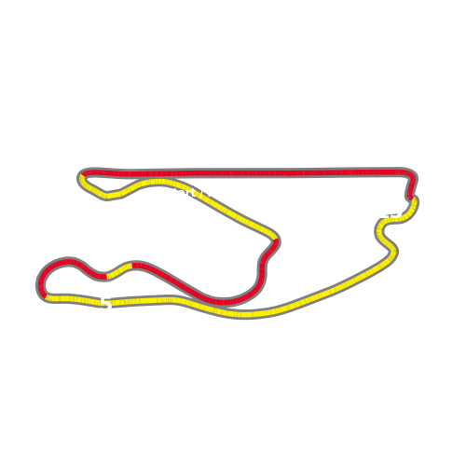


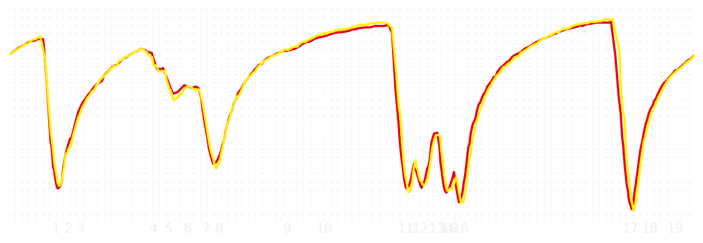
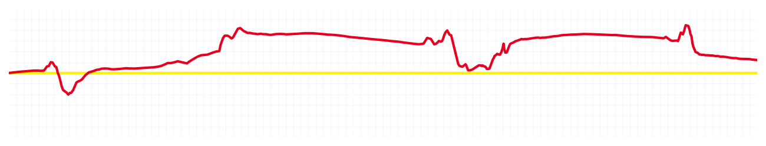
Miami GP Sprint Quali Q2
Charles Leclerc
Driver
Lewis Hamilton
Driver
Lap Time
01:27.467
01:27.546
Lap Time
Sector 1
29.043
Speed Trap 1
222 kp/h
Speed Trap 1
222 kp/h
Sector 1
29.190
Sector 2
33.309
Speed Trap 2
192 kp/h
Gap
-0.079
Gap
0.079
Speed Trap 2
190 kp/h
Sector 2
33.403
Sector 3
25.115
Speed Final Line
284 kp/h
Corner Advantage
12/20
Corner Advantage
8/20
Speed Final Line
287 kp/h
Sector 3
24.953
FULL THROTTLE
62%
60%
FULL THROTTLE
HEAVY BREAKING
15%
19%
HEAVY BREAKING
%LAP TIME
CORNERING
23%
21%
CORNERING
%LAP TIME
SPEED
SPEED
DELTA TIME
DELTA TIME

Slide 3

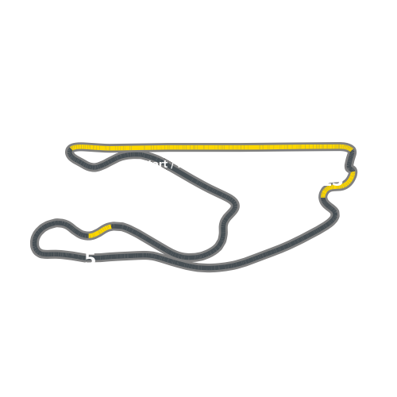


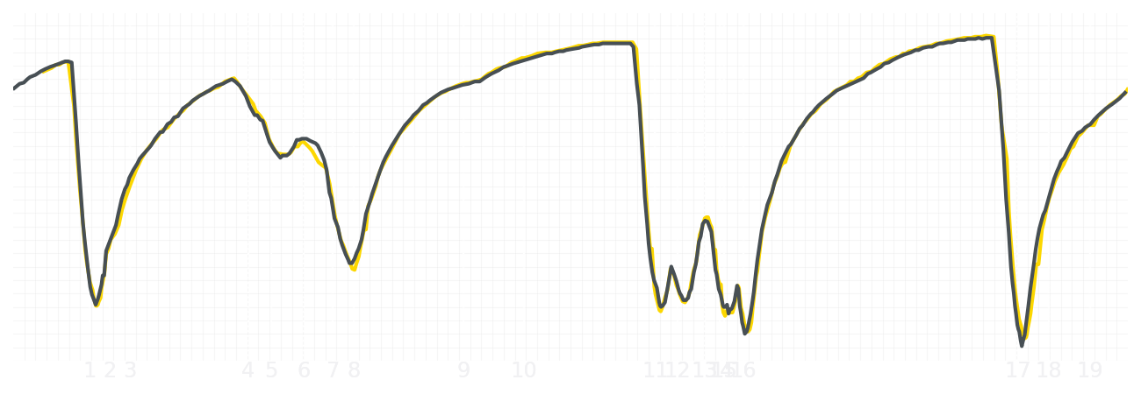
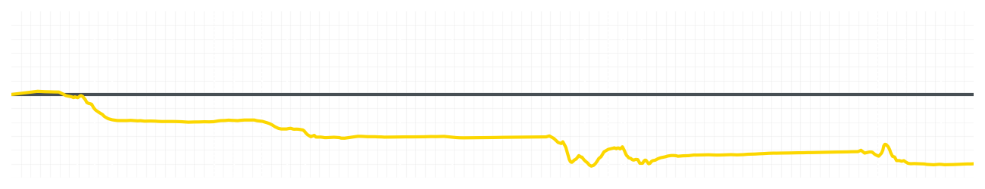
Miami GP Sprint Quali Q2
Liam Lawson
Driver
Isack Hadjar
Driver
Lap Time
01:28.375
01:27.773
Lap Time
Sector 1
29.420
Speed Trap 1
219 kp/h
Speed Trap 1
219 kp/h
Sector 1
29.016
Sector 2
33.599
Speed Trap 2
190 kp/h
Gap
0.602
Gap
-0.602
Speed Trap 2
190 kp/h
Sector 2
33.498
Sector 3
25.356
Speed Final Line
284 kp/h
Corner Advantage
15/20
Corner Advantage
5/20
Speed Final Line
282 kp/h
Sector 3
25.259
FULL THROTTLE
57%
57%
FULL THROTTLE
HEAVY BREAKING
18%
17%
HEAVY BREAKING
%LAP TIME
CORNERING
25%
26%
CORNERING
%LAP TIME
SPEED
SPEED
DELTA TIME
DELTA TIME

Slide 4

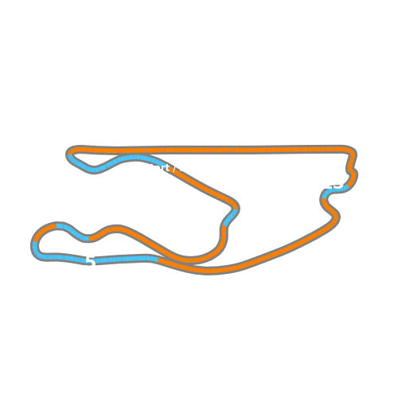


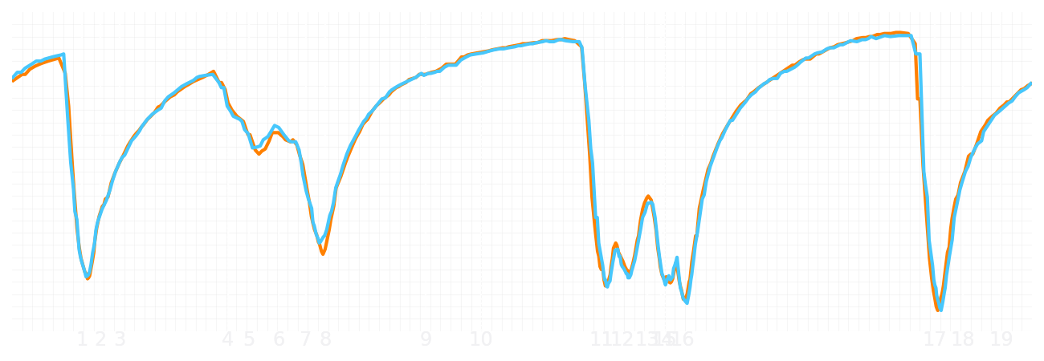
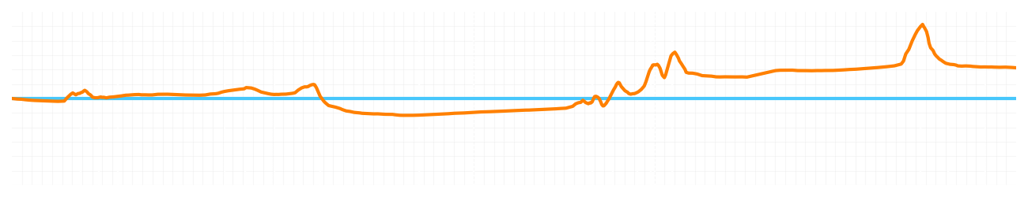
Miami GP Sprint Quali Q2
Lando Norris
Driver
Oscar Piastri
Driver
Lap Time
01:27.109
01:27.354
Lap Time
Sector 1
29.162
Speed Trap 1
222 kp/h
Speed Trap 1
224 kp/h
Sector 1
28.995
Sector 2
33.115
Speed Trap 2
192 kp/h
Gap
-0.245
Gap
0.245
Speed Trap 2
191 kp/h
Sector 2
33.405
Sector 3
24.832
Speed Final Line
286 kp/h
Corner Advantage
8/20
Corner Advantage
12/20
Speed Final Line
286 kp/h
Sector 3
24.954
FULL THROTTLE
57%
55%
FULL THROTTLE
HEAVY BREAKING
16%
18%
HEAVY BREAKING
%LAP TIME
CORNERING
27%
27%
CORNERING
%LAP TIME
SPEED
SPEED
DELTA TIME
DELTA TIME

